Slide 1













University of Diyala / College of Eng. Civil Engineering Department.
Class: 1st Year / Mathematics I
The derivative of a function 𝒇 is that function, denoted by f' , whose
function (functional) value at any limit point x of the domain of the
function f which is in the domain of the function f, denoted by f'(x), is given by the limit of the incremental ratio as the increment in the independent variable tends to zero. That is in notation,
_{f}' _{x = lim} f x+∆x -f(x) _{= lim} ∆y
∆x→0
∆x ∆x→0 ∆x
①
The derivative of a constant is zero; that is, for a constant c:
^{d} c=0
Examples:
1: y=7⟹y'=0 ,
②
If f x =x ^{n}, then
dx
2: y=a⟹y'=0 ,
3: y=5+ 3⟹y'=0
f' x = ^{d} x^{n}=nx^{n-1}
Examples:
1: y=x⁷⟹y'=7x⁶
dx
, 2: y=x¹³y⟹'=13x¹² ,
3: y=x⁻⁵⟹y'=-5x⁻⁶
1
'
1
₋1
3
'
3
1
2
4: y= x⟹y=x ⟹
y = x
5: y=x y⟹= x
2
2
2
2
2
1 1
₋5
5
₋8
6: y= _{3 x5} ⟹ y= ⟹
3⟹
'
'
5
y=x y =- x
3
7: y=x⟹y =1
x3
3
46

Slide 2







University of Diyala / College of Eng. Civil Engineering Department.
Class: 1st Year / Mathematics I
③
The derivative of a constant multiplied by a function is the constant multiplied by the derivative of the original function:
^{d} c f(x)=c f' x
Examples:
dx
1: f x =3x² ⟹ f' x =3. 2x =6x
2:
3:
f x = ² x⁷ ⟹ f' x = ² 7x⁶ = ¹⁴ x⁶
3 3 3
y=-2x⁴ ⟹ y'=-8x³
④
If f x , g x and h x are differentiable functions, then
^{d} f x +g x +h(x) =f' x +g' x +h' x
Examples:
dx
1: f x =5x ⁵-3x ²+6x+1⟹ f' x =25x ⁴-6x+6
2: f x =3x ¹⁰⁰-24x ³+7x²-x-2⟹ f' x =300x ⁹⁹-72x ²+14x-11
3:
_{x} 4
2⟹ '
1
3
5 3
4
2
y= 2x - +5x +x+π
y =5 2x - 4x +15x +1
4
4
⟹ y'=5 2x ⁴- ¹ 4x ³ +15x ²+1
4
4: y=
x ³-2x ²+x-4
⟹y=
x ³-2x ²+x-4
2 x
1
2x ²
1 1
5 3 1 ₋1
⟹y= ₂ x ²-x ²+ ₂ x ²-2x ²
1 5 3
1 1
1
₋3
3
1
₋1
2
'
2
2
⟹y = x - x + x -2
- x
2 2
2
2
2 2
2
5 3 1
3 1 ₋1 ₋3
⟹y= ₄ x ²- ₂ x ²+ ₄ x ²-x ²
47

Slide 3



University of Diyala / College of Eng. Civil Engineering Department.
Class: 1st Year / Mathematics I
⑤
If 𝒇 𝒂𝒏𝒅 𝒈 are differentiable functions, then
^{d} f x g x =f x g' x +g x f' x
dx
Examples:
1: f x = 3x²+1 7x³+x
f' x = 3x²+1 21x²+1 + 7x³+x 6x 2: y=3x 8x³-2
f' x =3x 24x² + 8x³-2 3 =72x³+24x³-6=96x³-6
If f,g and h are differentiable functions, then
^{d} f x g x h x =f x g x h' x +f x g' x h x +f' x g x h x
dx
Examples:
1: f g = x y z ⟹⟹ f' g = x y z'+xy'z+x'yz 2: y= 2x-5 x+2 x²-1
y'= 2x-5 x+2 2x + 2x-5 1 x²-1 + 2 x+2 x²-1
⑥
If f x and g x are differentiable functions and g x ≠0, then
d f x g x f' x -f x g' x
dx g x ⁼
g x
2
Example:
1: y= ^{x2} ⇒
_{y'=} x³+7 2x - x² 3x² ₌ 14x-x⁴
x³+7 ² x³+7 ²
x³+7
48

Slide 4




University of Diyala / College of Eng. Civil Engineering Department.
Class: 1st Year / Mathematics I
⑦
The derivative of a root is equal to the derivative of the radicand
divided by the index times the root, with the radicand raised to the index minus one.
If f x and g x are differentiable functions and g x ≠0, then
_{u}'
_{k}^{k} _{u}k-1
^{d k} u=
d x
Example1:
1: y= 5x+2 ⟹
2: y=⁴ 2x-4 ⟹
_{y'=} 5
2 5x+2
_{y'=} 2
4 2x-4 ³
2: y=³ 6x²+7x+2 ⟹
_{y'=} 12x+7
3 6x²+7x+2 ²
To calculate the slope of a line you need only two points from that
y
line, P₁(x₁, y₁) and P₂(x₂, y₂).
Therefore
P₂(x₂, y₂)
P₁(x₁, y₁)
change in y
_{m = Δy =} y₂-y₁
change in x
x
Δx x₂-x₁
While the slope for curve can be found by derivative the curve to
obtain the line or the first derivative which represented the slope where this slope will cross the curve at one point only.
49

Slide 5



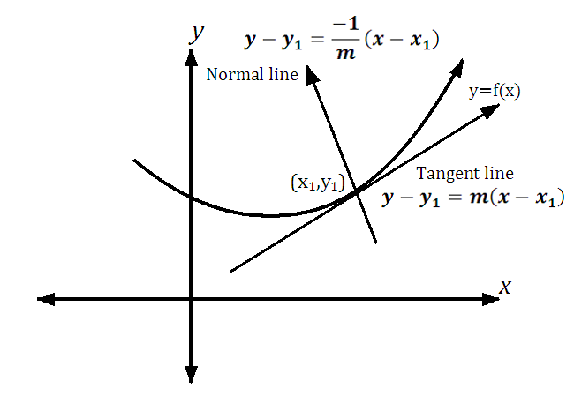

University of Diyala / College of Eng. Civil Engineering Department.
Class: 1st Year / Mathematics I
The slope=m=f' x = ^{dy}
dx
Therefore to find the slope we need the equation of curve and one
point.
Example 1 : Find the slope of the line tangent of the curve y=x³-2x+1 at x=1
Sol. m= y'=3x²-2
at x=1 ⇒ =m3 1 ²-2 =1
_{x}3
Example 2 :Find the slope of the curve at point (1,1): y= -2x+1
4
Sol. m= y'= ¹ 3x²-2⇒m= ³ x²-2
4 4
at point 1,1 ⇒ =m³ 1 ²-2 = ³ -2= ⁻⁵
4 4 4
The tangent line for any curve can be found if we have slope 𝒎 and
point using the equation
y-y₁=m x-x₁
:
1: If the line horizontal the slope is zero 2: If two lines orthogonal
(Perpendicular one to another) _{m=} 1
m ₁
50

Slide 6
University of Diyala / College of Eng. Civil Engineering Department.
Class: 1st Year / Mathematics I
3: If two lines parallel
m=m ₁
Therefore the normal line for any curve can be found by equation
y-y =
-1
m
x-x
1
1
2
Example 1: Find the equation of tangent line to the curve f(x)=4-x
at the point (1,3).
Solution m=f' x =-2x
at point 1 ,3
m=-2
y-y₁=m x-x₁ ⇒-3y=-2 x-1 ⇒=-y2x+5
Example 2: Find the equation of tangent line and normal to the curve
y= ¹ at the point (1/2,2).
x
Solution
m=y'= ⁻¹
_{x}2
at point ¹ ,2
m= ⁻¹ =-4
2
₁ 2
₂
The equation of tangent line with point 1/2 ,2 and m=-4
y-2=-4 x-1/2 ⇒=-y4x+4
The equation of normal line with point 1/2 ,2 and m=1/4
y-2= ¹ x- ¹ ⇒= ^{x}y + ¹⁵ 4 2 4 8
51

Slide 7

University of Diyala / College of Eng. Civil Engineering Department.
Class: 1st Year / Mathematics I
Example 3:If f x =2x²-x determine the points on the curve at which
the slope is parallel to 3x-y-4=0 ,and then find the equation of tangent line at this point.
Solution:
The slope of line 3-y'=0 ⇒y'=3 ⇒m₁=3
The slope of curve m=m₁=3 (parallel)
m=f' x =4x-1⇒ 4x-1=3⇒ x=1⇒y=1 The point is 1,1
The equation of tangent line with m=3 and point 1,1
y-1=3 x-1 ⇒ y=3x-2
Sometimes functions are given not in the form y=f (x) but in a more
complicated form in which it is difficult or impossible to express y explicitly in terms of x. Such functions are called implicit functions. In this unit we explain how these can be differentiated using implicit differentiation.
Example 1 : Find y' for the equation x²+y²=1
Sol. x²+y²=1⇒2x+2yy'=0⇒2yy'=-2x⇒y'= ^{-x}
y
Example 2: Find the slopes of the tangent lines to the curve x²+4y²=4 at the point ( 2, -1/ 2).
52

